Slide 1
Learning & categorization: Distributional factors in word learning and lexical category acquisition
Giovanni Cassani & Robert Grimm
21st October - ATiLA16
Notes:
…and in particular, we’ll focus on two aspects of these two tasks:

Slide 2
Introduction
role of multi-word units in word learning
role of distributional input properties in word categorization
Robert Grimm & Giovanni Cassani - 21/10/16 ATilA 16

Slide 3
Overview
Word Learning
Multi-Word Units in Learning and Processing
Model
Corpora
Independent Variable
Dependent Variables
Results
Conclusions
Lexical Category Acquisition
What do we know?
What do we miss?
Good contexts
Easy words
Conclusions
Robert Grimm & Giovanni Cassani - 21/10/16 ATilA 16

Slide 4
Overview
Word Learning
Multi-Word Units in Learning and Processing
Model
Corpora
Independent Variable
Dependent Variables
Results
Conclusions
Lexical Category Acquisition
What do we know?
What do we miss?
Good contexts
Easy words
Conclusions
Robert Grimm & Giovanni Cassani - 21/10/16 ATilA 16
Notes:
“let’s go”, “I’m sorry”

Slide 5
Word Learning – Multi-Word Units in learning and processing
Multi-Word Units
Children’s first production appear to be fossilized MWUs
Tomasello (1992, 2000)
Childrens’ inflection errors are less prevalent within frequent MWUs
Arnon & Clark (2011)
Frequent MWUs are processed more quickly by children
Bannard & Matthews (2008)
As well as by adults
Arnon & Snider (2010)
Arnon & Priva (2014)
Robert Grimm & Giovanni Cassani - 21/10/16 ATilA 16

Slide 6
Word Learning - Multi-Word Units in learning and processing
Multi-Word Units
Goal: Compare effect of MWUs on child word learning to effect on adult lexical processing
Robert Grimm & Giovanni Cassani - 21/10/16 ATilA 16

Slide 7
Word Learning - Model
Chunk-based Learner
Chunk-based Learner
(McCauley & Christiansen, 2014)
Process corpus utterance by utterance; increment word counts and calculate probability of previous word given the current word
Any two words w_{i-1}, w_{i} form part of an MWU if p(w_{i-1} | w_{i}) > running average
Else, create a new MWU with w_{i} as its only member
Robert Grimm & Giovanni Cassani - 21/10/16 ATilA 16

Slide 8
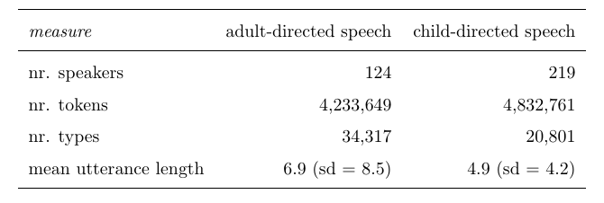
Word Learning - Corpora
Corpora
Adult-Directed Speech: spoken informal component of the British National Corpus
Child-Directed Speech: all British English corpora with POS tags from the CHILDES database (MacWhinney, 200)
Robert Grimm & Giovanni Cassani - 21/10/16 ATilA 16

Slide 9
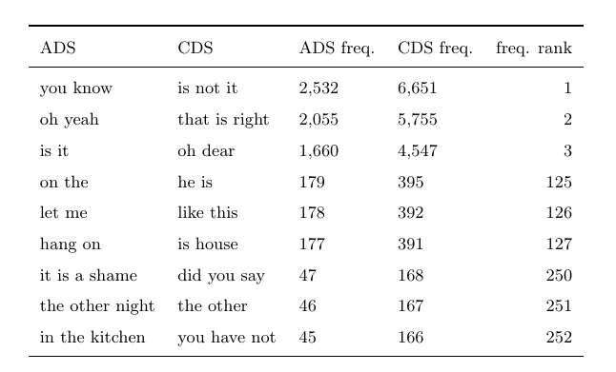
Word Learning
Example Multi-Word Units
Robert Grimm & Giovanni Cassani - 21/10/16 ATilA 16

Slide 10
Word Learning – Independent Variable
Independent Variable
For each target word, count number of different MWUs that contain it
Consider only MWUs with frequency > 1
MWU tokens: 185,000 in ADS; 435,00 in CDS
MWU types: 40,00 in ADS; 75,000 in CDS
Robert Grimm & Giovanni Cassani - 21/10/16 ATilA 16

Slide 11
Word Learning – Dependent Variable
Dependent Variables
Reaction Times: reaction times from a Lexical Decision Task for 28,00 target words (English Lexicon Project)
Age of first production (AoFP): order transcripts from all American English CHILDES corpora by child’s mean length of utterance (MLU)
use MLU of first transcript where word appears as AoFP (4,500 target words)
Robert Grimm & Giovanni Cassani - 21/10/16 ATilA 16

Slide 12
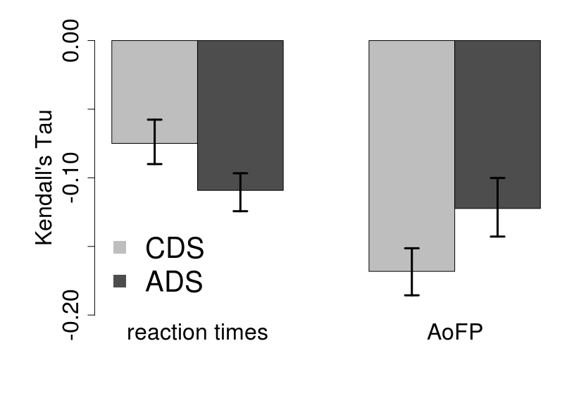
Word Learning - Results
Results
Robert Grimm & Giovanni Cassani - 21/10/16 ATilA 16

Slide 13
Word Learning - Conclusions
Conclusions
MWUs could both benefit child word learning and adult lexical processing
But MWUs have a stronger effect on word learning than on adult processing
Word learning mechanisms could be especially dependent on MWUs
Robert Grimm & Giovanni Cassani - 21/10/16 ATilA 16

Slide 14
Overview
Word Learning
Multi-Word Units in Learning and Processing
Model
Corpora
Independent Variable
Dependent Variables
Results
Conclusions
Lexical Category Acquisition
What do we know?
What do we miss?
Good contexts
Easy words
Conclusions
Robert Grimm & Giovanni Cassani - 21/10/16 ATilA 16

Slide 15
Lexical Category Acquisition – What do we know?
How do they manage?
Several theories of bootstrapping of lexical categories:
Prosody (Christophe & al, 2008)
Phonetics (Christophe & al, 1997)
Syntax (Gleitman & Gillette, 1995)
Semantics (Pinker, 1987)
Distributional patterns (Maratsos & Chalkley, 1980)
Robert Grimm & Giovanni Cassani - 21/10/16 ATilA 16

Slide 16
Lexical Category Acquisition – What do we know?
How do they manage?
Several theories of bootstrapping of lexical categories:
Prosody (Christophe & al, 2008)
Phonetics (Christophe & al, 1997)
Syntax (Gleitman & Gillette, 1995)
Semantics (Pinker, 1987)
Distributional patterns (Maratsos & Chalkley, 1980)
Robert Grimm & Giovanni Cassani - 21/10/16 ATilA 16

Slide 17
Lexical Category Acquisition – What do we know?
What are the useful contexts?
Frequent Frames (Mintz, 2003)
Flexible Frames (St. Clair & al, 2010)
Bigrams vs trigrams? (Monaghan & al, 2004)
Utterance boundaries? (Freudenthal & al, 2008)
Studies pick a type of context quite arbitrarily and evaluate how good categories can be induced.
Robert Grimm & Giovanni Cassani - 21/10/16 ATilA 16

Slide 18
Lexical Category Acquisition – What do we know?
Which algorithms do the job?
Incremental Bayesian clustering (Parisien, 2008)
Incremental Entropy-based clustering (Chrupała & Alishahi, 2010)
Mosaic (Freudenthal & al, 2016)
…
Typically, the evaluation concerns whether good categories are learned and whether learning follows the developmental pattern.
Robert Grimm & Giovanni Cassani - 21/10/16 ATilA 16

Slide 19
Lexical Category Acquisition – What do we miss?
Bridging a gap
Studies on bootstrapping still rely a lot on starting assumptions (which contexts are useful, what makes them salient and useful, what does a plausible model look like, …), but no compelling argument for these assumptions exists yet.
We aim to look at what distributional factors determine how useful a context is and how easy it is to categorize a word.
Robert Grimm & Giovanni Cassani - 21/10/16 ATilA 16

Slide 20
Lexical Category Acquisition – What do we miss?
The experimental setting
Supervised PoS tagging experiment with TiMBL (no feature weighting, cosine, 1 NN)
five categories (nouns, verbs, adjectives, adverbs, function words)
13 corpora of English child-directed speech, 70% for training, 30% for test
longitudinal analysis (incrementally larger training)
Robert Grimm & Giovanni Cassani - 21/10/16 ATilA 16

Slide 21
Lexical Category Acquisition – What do we miss?
Variables
Context type
# constituents
Token frequency
Diversity
Avgerage conditional probability
Entropy (normalized)
Time
Gain ratio (contexts)
Hits (words)
Robert Grimm & Giovanni Cassani - 21/10/16 ATilA 16

Slide 22
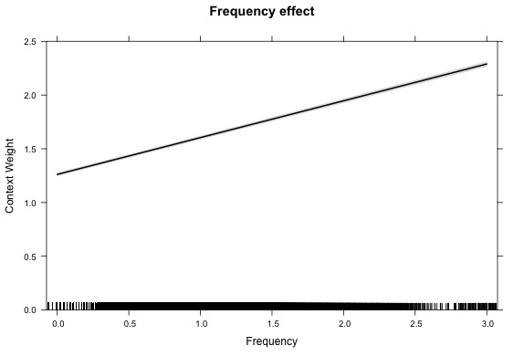
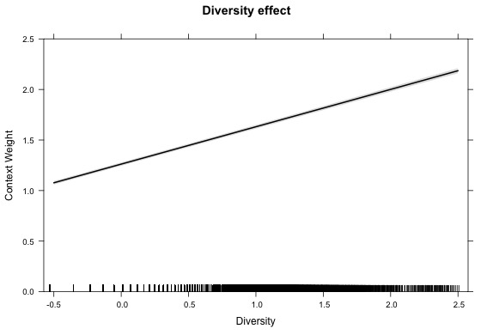
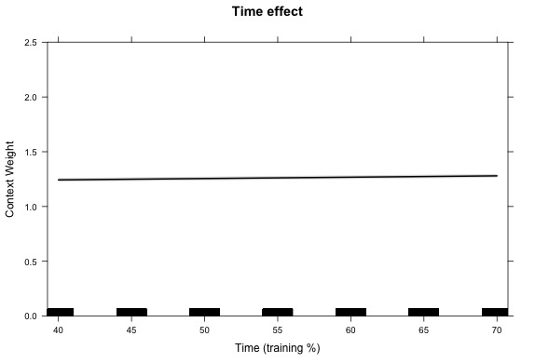
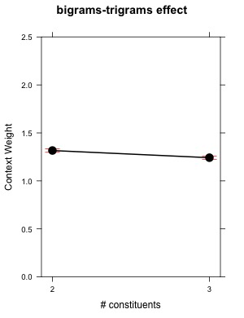
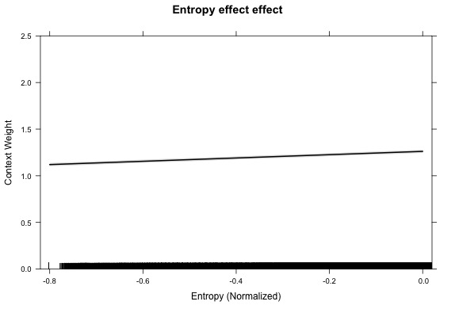
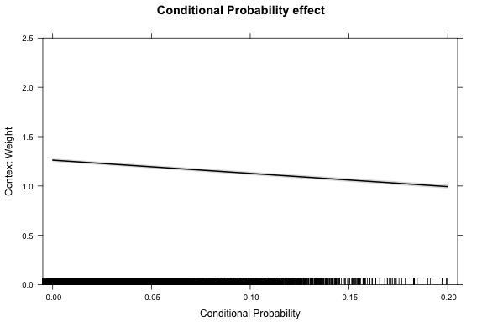
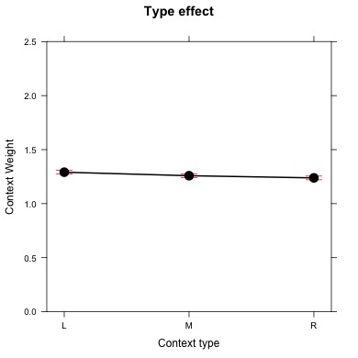
Lexical Category Acquisition – Good contexts
Main effects
Robert Grimm & Giovanni Cassani - 21/10/16 ATilA 16

Slide 23
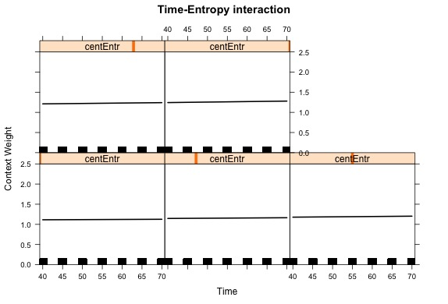
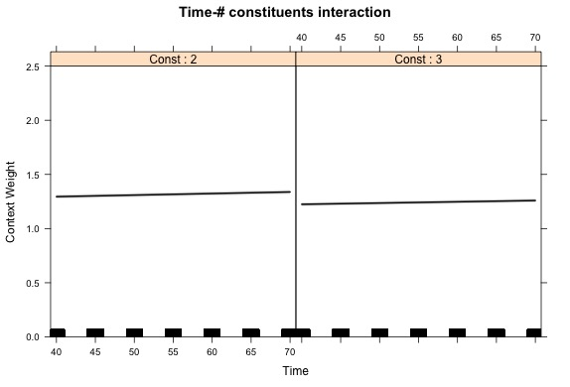
Lexical Category Acquisition – Good contexts
Interactions (I)
Robert Grimm & Giovanni Cassani - 21/10/16 ATilA 16

Slide 24
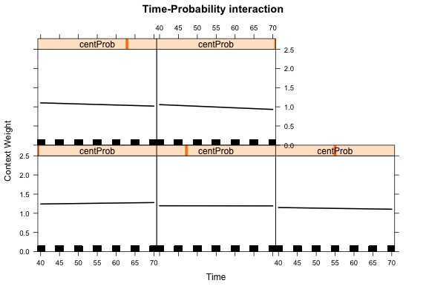
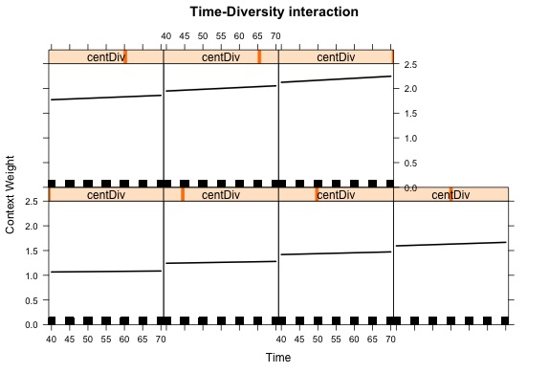
Lexical Category Acquisition – Good contexts
Interactions (II)
Robert Grimm & Giovanni Cassani - 21/10/16 ATilA 16

Slide 25
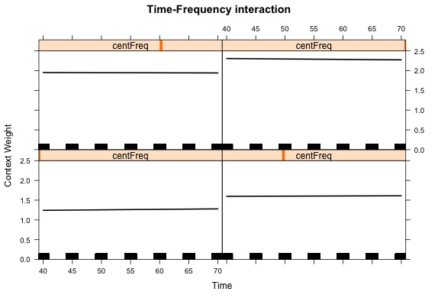
Lexical Category Acquisition – Good contexts
Interactions (III)
Robert Grimm & Giovanni Cassani - 21/10/16 ATilA 16

Slide 26
Lexical Category Acquisition – Good contexts
Interpreting results
Contexts are better when:
Frequent and occurring with many different words
Harder to predict given the words they occur with
Bigrams and left-contexts
The entropy of the distribution over words is low
Over time, diversity becomes more important, frequency less; probability becomes less important, the higher its initial value; for all other predictors, Gain Ratio becomes generally (slightly) more important with time.
Robert Grimm & Giovanni Cassani - 21/10/16 ATilA 16

Slide 27
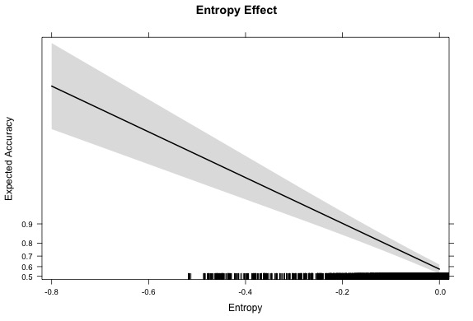
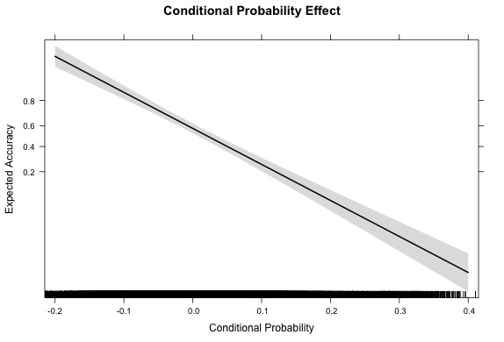
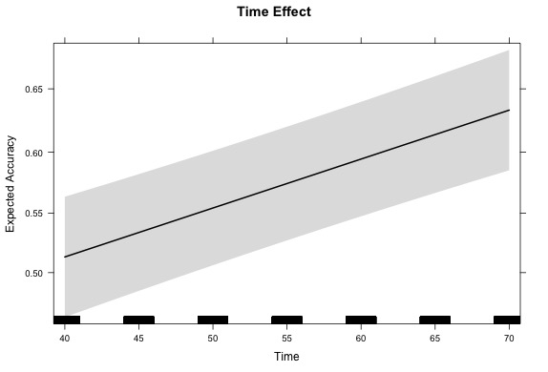
Lexical Category Acquisition – Easy words
Main Effects
Robert Grimm & Giovanni Cassani - 21/10/16 ATilA 16

Slide 28
Lexical Category Acquisition – Good words
Interpreting results
Words are easier to categorize:
With more exposure to language
When they are evenly spread across the contexts they occur with
When it’s on average hard to predict them given the contexts they occur with
Robert Grimm & Giovanni Cassani - 21/10/16 ATilA 16

Slide 29
Lexical Category Acquisition – Conclusions
Good categorization
Good contexts occur with many words and have high entropy: they occur equally frequently with many different words. Easy words have high entropy.
This experiment should be replicated with other languages with more complex morphology, to elucidate the generality of these findings.
Robert Grimm & Giovanni Cassani - 21/10/16 ATilA 16

Slide 30
Lexical Category Acquisition – Conclusions
Easy to learn (!)= easy to group?
Roy & al (2015) claim that words are acquired earlier when they appear in temporally, spatially, or semantically constrained contexts. We saw that words are easy to categorize when they occur often with the same contexts.
Interactions between entropy and diversity appear to play a large role and haven’t been explored.
Robert Grimm & Giovanni Cassani - 21/10/16 ATilA 16

Slide 31
Thank you!

Slide 32
Questions?

Slide 33
References
Maratsos, M. P., & Chalkley, M. A. (1980). The Internal Language of Children Syntax: The nature and ontogenesis of syntactic categories. In K. E. Nelson (Ed.), Children’s language (Vol. 2, pp. 127-213). New York, NY: Gardner Press.
Pinker, S. (1987). The bootstrapping problem in language acquisition. In B. MacWhinney (Ed.), Mechanisms of language acquisition. Hillsdale, NJ: Lawrence Erlbaum Associates.
Gleitman, L. R., & Gillette, J. (1996). The role of syntax in verb-learning. In P. Fletcher & B. MacWhinney (Eds.), The Handbook Of Child Language (pp. 413-427). Oxford, UK: Blackwell.
Christophe, A., Guasti, T., Nespor, M., Dupoux, E., & Van Ooyen, B. (1997). Reflections on phonological bootstrapping: Its role for lexical and syntactic acquisition. Language and Cognitive Processes, 12(5-6), 585-612.
Christophe, A., Millotte, S., Bernal, S., & Lidz, J. (2008). Bootstrapping Lexical and Syntactic Acquisition. Language and Speech, 51(1-2), 61-75.
Mintz, T. H. (2003). Frequent frames as a cue for grammatical categories in child directed speech. Cognition, 90(1), 91-117.
Monaghan, P., & Christiansen, M. H. (2004). What distributional information is useful and usable for language acquisition. In D. G. Kenneth Forbus, Terry Regier (Ed.), Proceedings of the 26th annual conference of the Cognitive Science Society. Austin, TX: Cognitive Science Society.
Freudenthal, D., Pine, J. M., & Gobet, F. (2008). On the Utility of Conjoint and Compositional Frames and Utterance Boundaries as Predictors of Word Categories. In V. Sloutsky, B. Love, & K. McRae (Eds.), Proceedings of the 30th Annual Conference of the Cognitive Science Society (pp. 1947-1952). Austin, TX: Cognitive Science Society.
St. Clair, M. C., Monaghan, P., & Christiansen, M. H. (2010). Learning grammatical categories from distributional cues: Flexible frames for language acquisition. Cognition, 116(3), 341-360.
Parisien, C. (2008). An Incremental bayesian Model for Learning Syntactic Categories. In A. Clark & K. Toutanova (Eds.), 12th Conference on Computational Natural Language Learning (CoNLL) (pp. 89-96). Stroudsburg, PA: Association for Computational Linguistics.
Chrupała, G., & Alishahi, A. (2010). Online Entropy-based Model of Lexical category Acquisition. In M. Lapata & A. Sarkar (Eds.), Proceedings of the 14th Conference on Computational Natural Language Learning (CoNLL) (pp. 182-191). Stroudsburg, PA: Association for Computational Linguistics.
Freudenthal, D., Pine, J. M., Jones, G., & Gobet, F. (2016). Developmentally plausible learning of word categories from distributional statistics. In A. Papafragou, D. Grodner, D. Mirman, & J. C. Trueswell (Eds.), Proceedings of the 38th Annual Conference of the Cognitive Science Society (pp. 674). Austin, TX: Cognitive Science Society.
Robert Grimm & Giovanni Cassani - 21/10/16 ATilA 16

